Slide 1
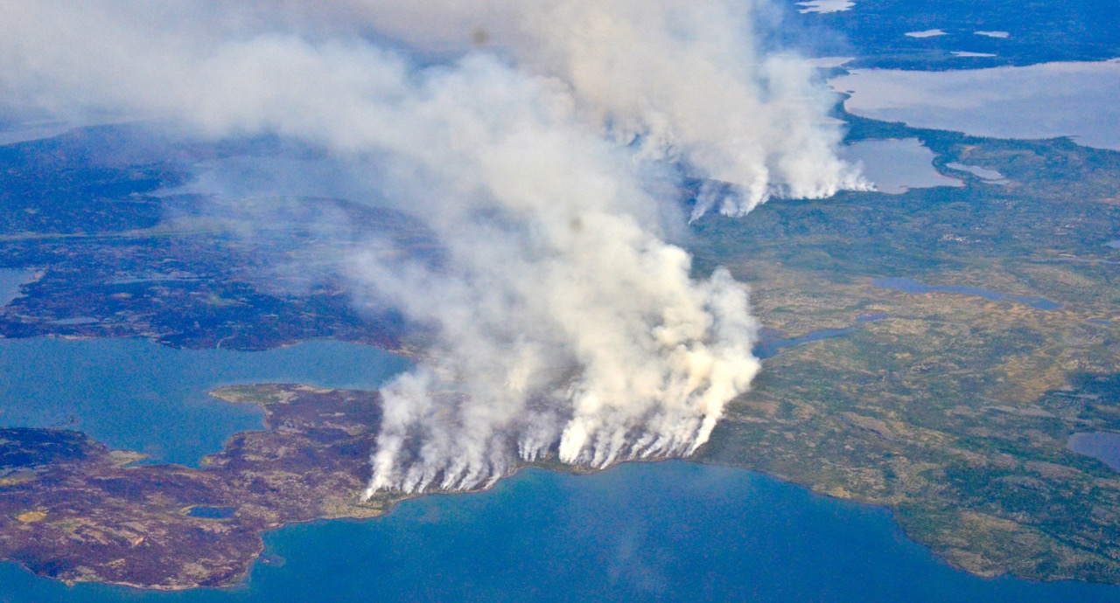
Arctic-Boreal Vulnerability Experiment
2019 Airborne Flights 12 July – 4 August
LVIS Deployment
July 13
Peter Griffith
ABoVE Project Manager
NASA Carbon Cycle & Ecosystems Office
Goddard Space Flight Center For Hank Margolis, Mike Falkowski, Bruce Tagg, Jack Kaye
NASA HQ
2019
2014 NWT Fires Northeast of Yellowknife Photo: Peter Griffith

Slide 2
13 July 2019/DOY 194 Yellowknife – Yellowknife
Instrument/Aircraft/Crew
LVIS Facility and LVIS Classic (GSFC)
NASA5 Gulfstream V (JSC)
REPORT DATE: 13 July 2019
Aircraft Status: GREEN
LVIS Status: GREEN
Current Deployment Location: Yellowknife, Canada
Crew: W. Ehrenstrom (PIC), Kenn Cook, Alan Flint, Mike Brown, Angel Vasquez
Instrument Operators: Albert Wu, David Rabine, Mike Mullin
Data Processors: Helen Cornejo, Sarah Story
Instrument PI: Bryan Blair
Processing Lead: Michelle Hofton
Science Lead: Peter Griffith
Notes:
Instrument/Aircraft/Crew

Slide 3
13 July 2019/DOY 194 Yellowknife – Yellowknife
Operations Summary:
Yellowknife to Yellowknife sortie
Guest flyers Colin Avey and Melanie Desjardins from GNWT Geomatics
Performed calibration pitch & rolls over Great Slave Lake
Generally clear with popcorn cumulus from time to time
The southern part of the Peace-Athabascan Delta and Ft. McMurray were obscured by clouds and may require reflight.
BERMS TomoSAR and Manitoba 2010 lidar repeat lines were partly cloudy allowing acceptable data collection.
14 July was a mandatory crew rest day
Notes:
Operations Summary

Slide 4
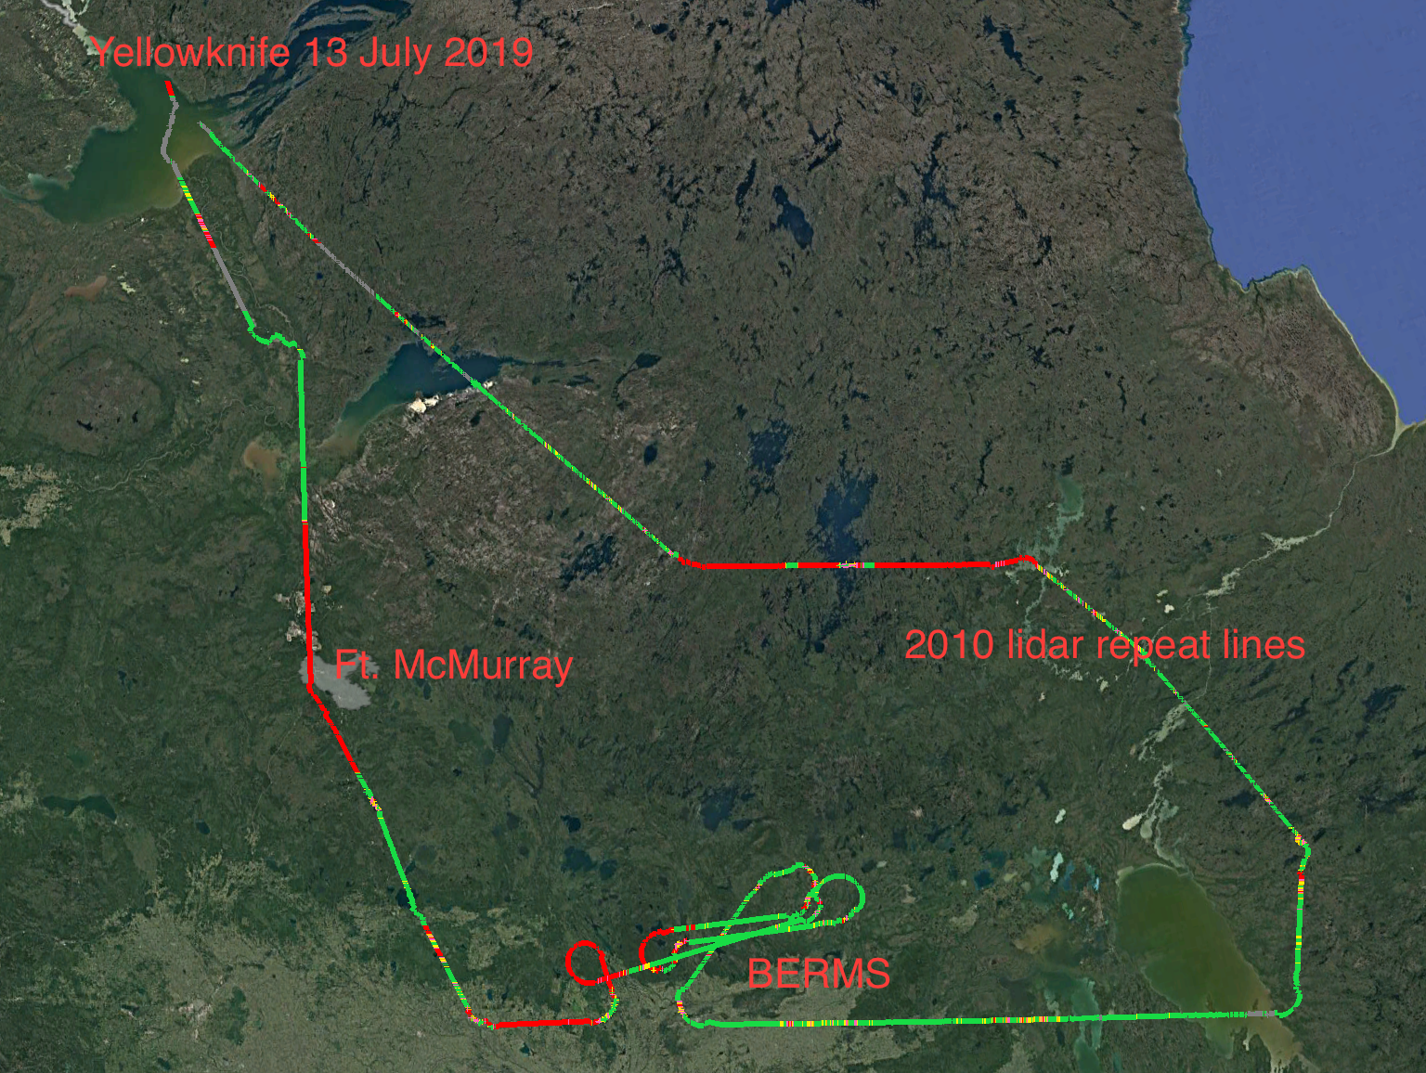
13 July 2019/DOY 194 Yellowknife – Yellowknife
LVIS Coverage Quality
Green = >50% returns
Yellow = >20 to 50%
Orange = 10 to 20%
Pink = 1 to 10%
Red = zero returns
Gray = returns w/o DEM
Notes:
LVIS Coverage Quality

Slide 5
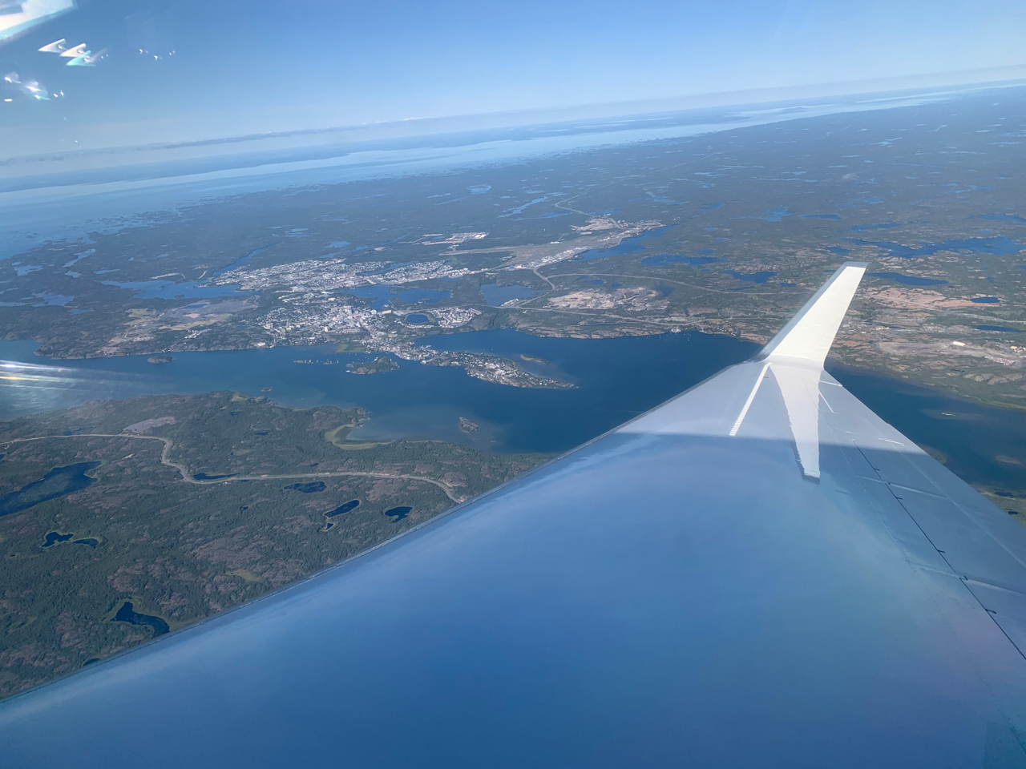
13 July 2019/DOY 194 Yellowknife – Yellowknife
Yellowknife on a clear day from NASA5
Notes:
Wx
FAA Camera Locations
Windy Clouds, AOD
GMAO Wx

Slide 6
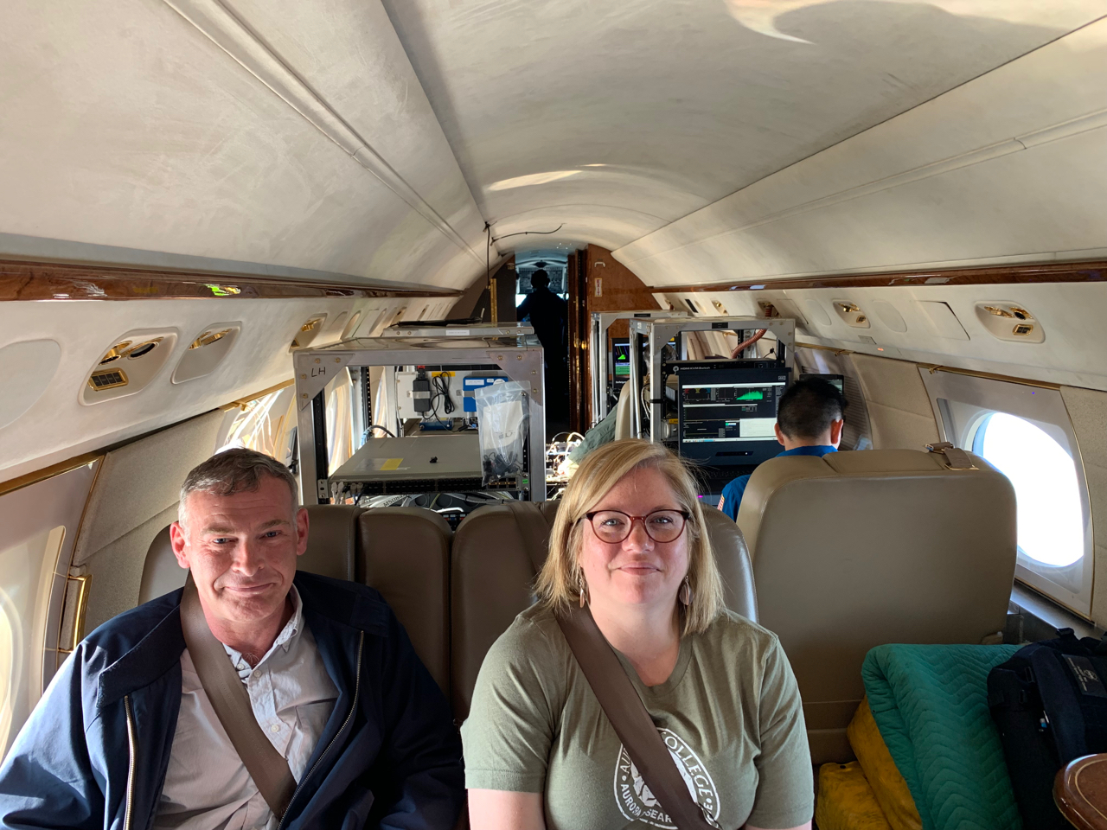
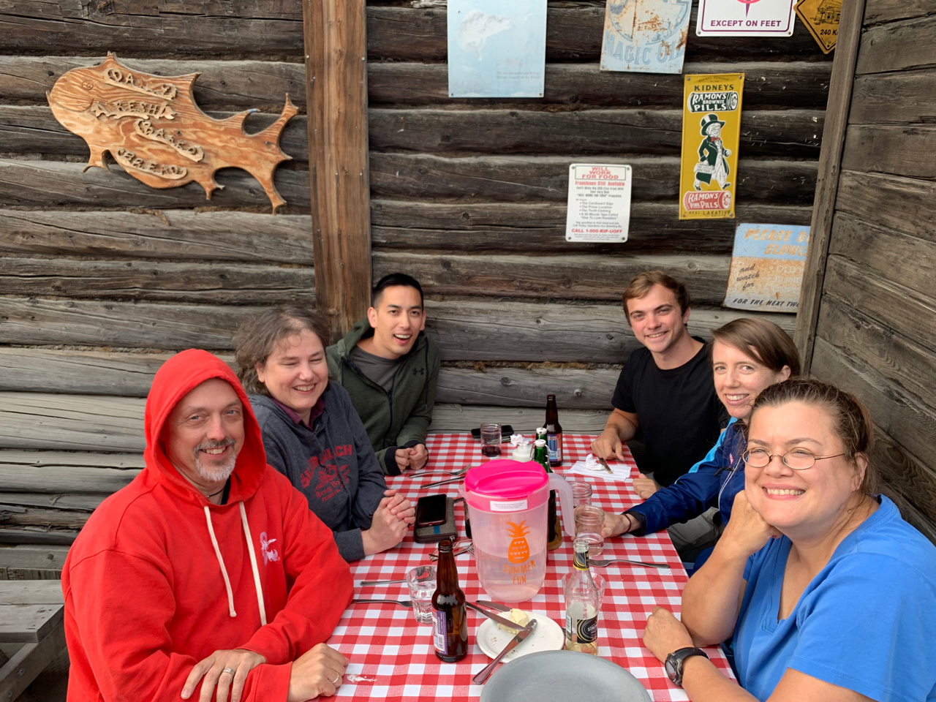
13 July 2019/DOY 194 Yellowknife – Yellowknife
Colin Avey and Melanie Desjardins from GNWT Geomatics
L-R: Rabine, Hofton, Wu, Mullin, Story, Cornejo at the legendary Bullocks Fish House in Yellowknife
Notes:
Photos

Slide 7
Backup

